Slide 1
Chapter 06
Dynamic Programming

Slide 2
Chapter 06_01
Dynamic Programming
Binomial Coefficients

Slide 3

Dynamic Programming (i.e., Dynamic Planning)
Dynamic programming (DP):
The DP approach is similar to divide-and-conquer
Divide an instance of a problem into smaller instances.
Solve each of the small instances only once first, and saves their results in a table (an array).
Later, whenever a result is needed, look it up instead of recomputing it.
A solution to the original problem can then be obtained.

Slide 4

An example of dynamic programming:
Compute the nth Fibonacci term by constructing in sequence the first n+1 terms in an array F[0 .. n]
Polynomial Algorithm Fib(n)
//Computes iteratively the nth Fibonacci number, using definition
Input: A nonnegative integer n.
Output: The nth Fibonacci number.
create an array F[0 .. n];
F[0] ← 0; F[1] ← 1;
for i ← 2 to n do
F[i] ← F[i-1] + F[i-2]
return F[n].
In a dynamic programming algorithm, construct a solution from the bottom up in an array (or sequence of arrays).
Dynamic programming is a bottom-up approach.
0 | 1 | 1 | 2 | 3 | … | n-1 | n

Slide 5
Dynamic Programming (i.e., Dynamic Planning)
Steps in developing a dynamic programming algorithm:
Establish a recursive property that gives the solution to an instance of the problem.
Solve an instance of the problem in a bottom-up fashion by solving smaller instances first.
Another example is using dynamic programming compute the binomial coefficient.

Slide 6
Dynamic Programming (i.e., Dynamic Planning)
Dynamic programming (comes from control theory):
“programming” refers to a tabular method (planning), and does not refer to computer programming (not writing computer code).
An algorithm design technique.
Invented by a US Mathematician, Richard Bellman in 1950.
A method for optimizing multistage decision process.

Slide 7
Dynamic programming
Permutations
A permutation of a finite set S is
an ordered sequence of all the elements of S, with each element appearing exactly once.
Example:
Let S = {a, b, c}, There are 6 = 3! permutations of S.
abc, acb, bac, bca, cab, cba.
There are n! permutations of a set S of n elements.
The first element of sequence can be chosen in n ways, the second in n-1 ways, the third in n-2 ways, and so on.

Slide 8
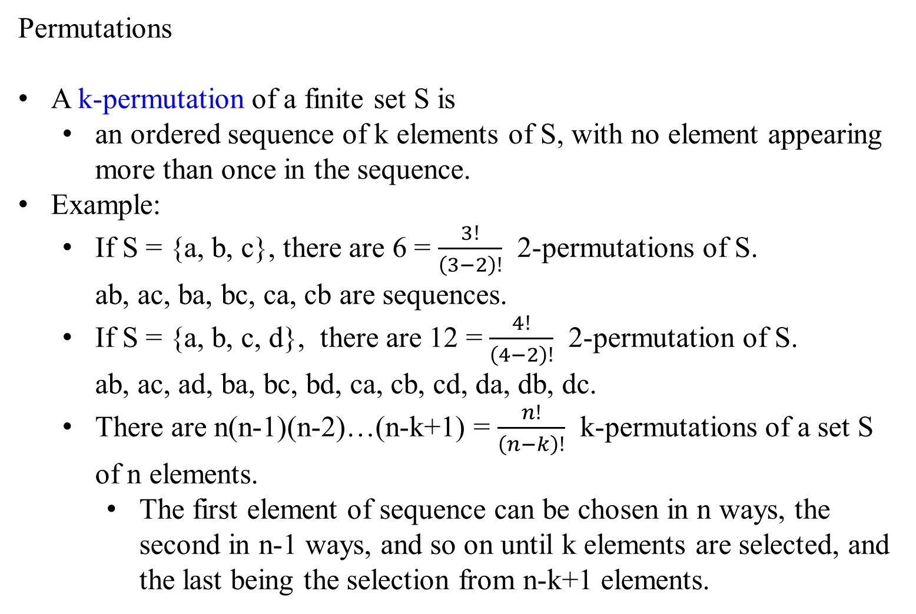
Permutations
A k-permutation of a finite set S is
an ordered sequence of k elements of S, with no element appearing more than once in the sequence.
Example:
If S = {a, b, c}, there are 6 = $\frac{3!}{\left(3−2\right)!}$ 2-permutations of S. ab, ac, ba, bc, ca, cb are sequences.
If S = {a, b, c, d}, there are 12 = $\frac{4!}{\left(4−2\right)!}$ 2-permutation of S. ab, ac, ad, ba, bc, bd, ca, cb, cd, da, db, dc.
There are n(n-1)(n-2)…(n-k+1) = $\frac{n!}{\left(n−k\right)!}$ k-permutations of a set S of n elements.
The first element of sequence can be chosen in n ways, the second in n-1 ways, and so on until k elements are selected, and the last being the selection from n-k+1 elements.

Slide 9
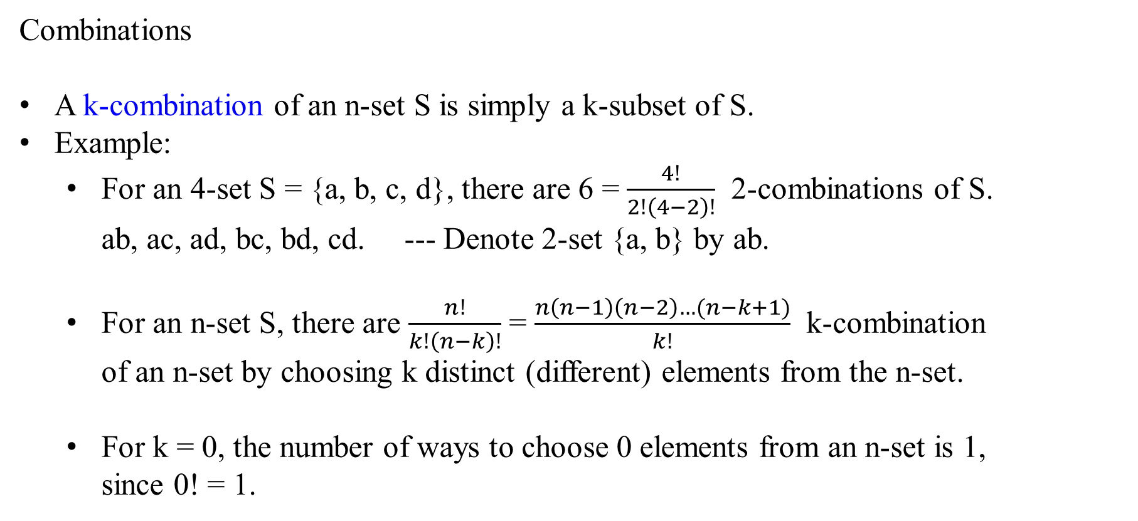
Combinations
A k-combination of an n-set S is simply a k-subset of S.
Example:
For an 4-set S = {a, b, c, d}, there are 6 = $\frac{4!}{2!\left(4−2\right)!}$ 2-combinations of S. ab, ac, ad, bc, bd, cd. --- Denote 2-set {a, b} by ab.
For an n-set S, there are $\frac{n!}{k!\left(n−k\right)!}$ = $\frac{n\left(n−1\right)\left(n−2\right)…(n−k+1)}{k!}$ k-combination of an n-set by choosing k distinct (different) elements from the n-set.
For k = 0, the number of ways to choose 0 elements from an n-set is 1, since 0! = 1.

Slide 10
Expand binomials of the form (a+b)^{n}
(a + b)⁰ = 1
(a + b)¹ = a + b
(a + b)² = a² + 2ab + b²
(a + b)³ = a³ + 3a²b + 3ab² + b³
(a + b)⁴ = a⁴ + 4a³b + 6a²b² + 4ab³ + b³
(a + b)⁵ = a⁵ + 5a⁴b + 10a³b² + 10a²b³ + 5ab⁴ + b⁵
Using Pascal’s Triangle-Written in a triangular array the coefficients
(a + b)⁰ |  |  |  |  |  |  | 1 |  |  |  |  |  |  | n=0
(a + b)¹ |  |  |  |  |  | 1 |  | 1 |  |  |  |  |  | n=1
(a + b)² |  |  |  |  | 1 |  | 2 |  | 1 |  |  |  |  | n=2
(a + b)³ |  |  |  | 1 |  | 3 |  | 3 |  | 1 |  |  |  | n=3
(a + b)⁴ |  |  | 1 |  | 4 |  | 6 |  | 4 |  | 1 |  |  | n=4
(a + b)⁵ |  | 1 |  | 5 |  | 10 |  | 10 |  | 5 |  | 1 |  | n=5

Slide 11
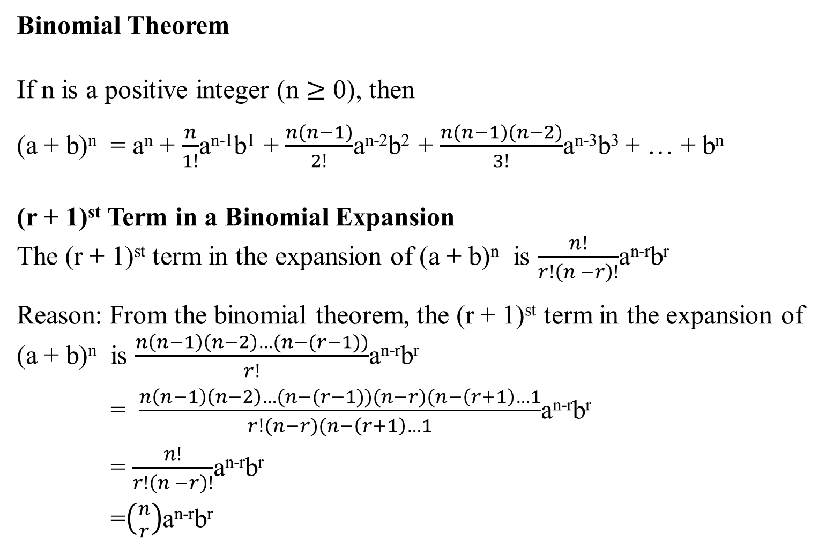
Binomial Theorem
If n is a positive integer (n $≥$ 0), then
(a + b)^{n} = a^{n} + $\frac{n}{1!}$a^{n-1}b¹ + $\frac{n(n−1)}{2!}$a^{n-2}b² + $\frac{n(n−1)(n−2)}{3!}$a^{n-3}b³ + … + b^{n}
(r + 1)^{st} Term in a Binomial Expansion
The (r + 1)^{st} term in the expansion of (a + b)^{n} is $\frac{n!}{r!\left(n −r\right)!}$a^{n-r}b^{r}
Reason: From the binomial theorem, the (r + 1)^{st} term in the expansion of (a + b)^{n} is $\frac{n\left(n−1\right)\left(n−2\right)…(n−(r−1))}{r!}$a^{n-r}b^{r}
= $\frac{n\left(n−1\right)\left(n−2\right)…(n−(r−1))(n−r)(n−\left(r+1\right)…1}{r!(n−r)(n−\left(r+1\right)…1}$a^{n-r}b^{r}
= $\frac{n!}{r!\left(n −r\right)!}$a^{n-r}b^{r}
=$\left({n \atop r}\right)$a^{n-r}b^{r}

Slide 12
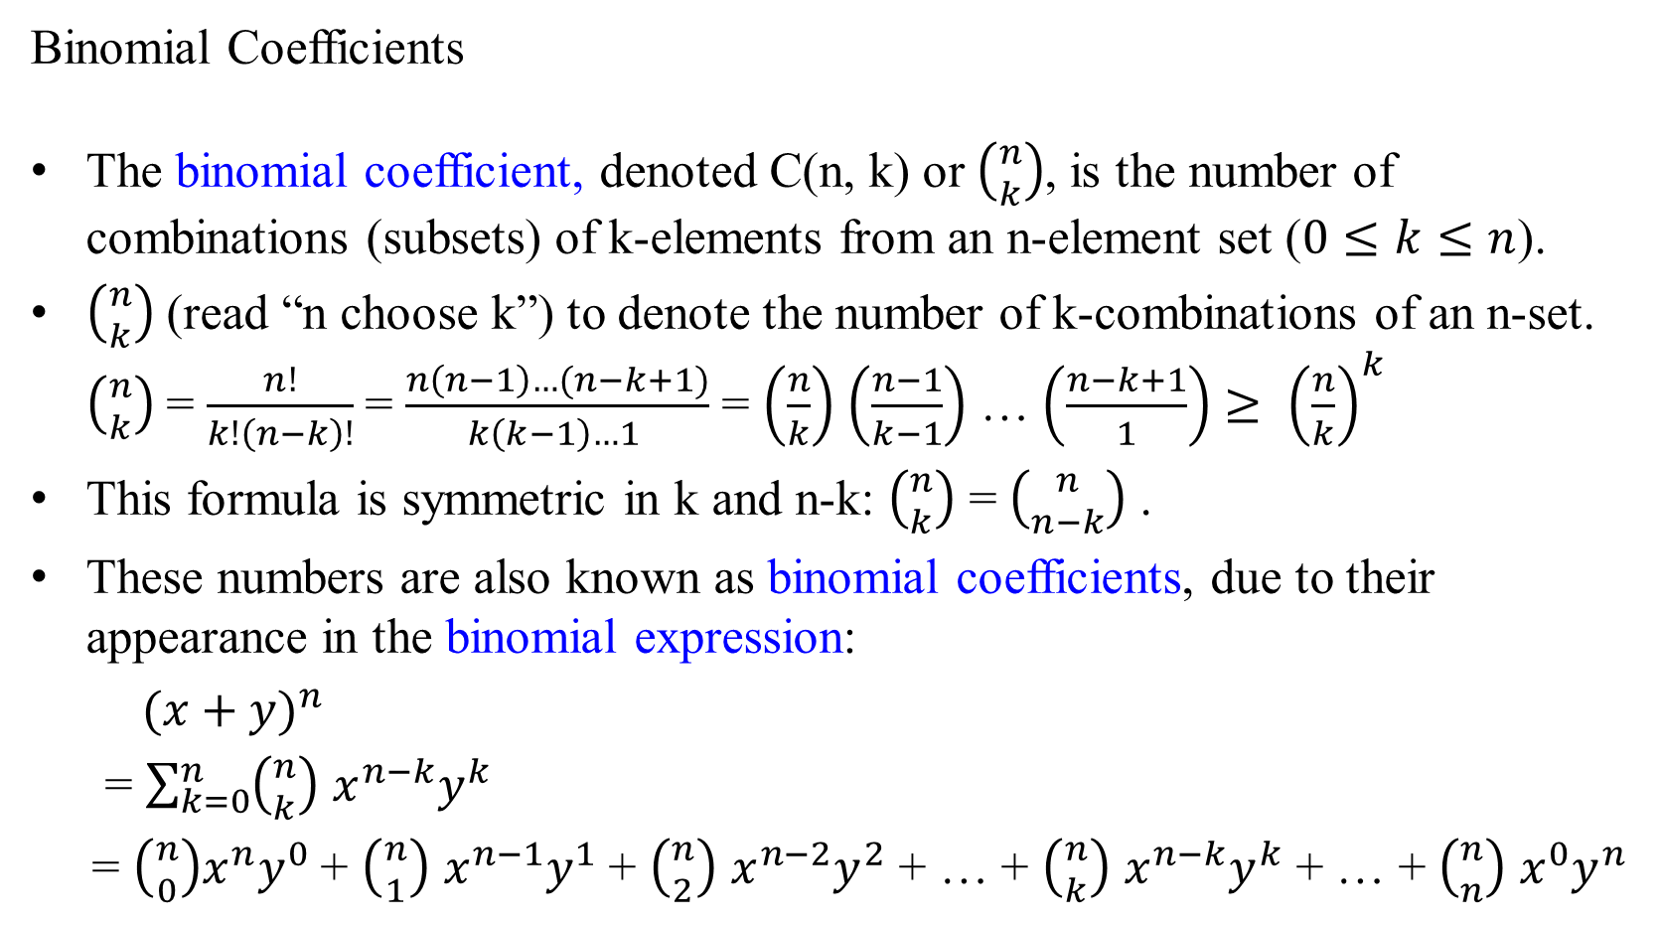

Binomial Coefficients
The binomial coefficient, denoted C(n, k) or $\left({n \atop k}\right)$, is the number of combinations (subsets) of k-elements from an n-element set ($0≤k≤n$).
$\left({n \atop k}\right)$ (read “n choose k”) to denote the number of k-combinations of an n-set. $\left({n \atop k}\right)$ = $\frac{n!}{k!\left(n−k\right)!}$= $\frac{n\left(n−1\right)…(n−k+1)}{k\left(k−1\right)…1 }$ = $\left(\frac{n}{k}\right)$ $\left(\frac{n−1}{k−1}\right)$ … $\left(\frac{n−k+1}{1}\right)$ $≥$ ${\left(\frac{n}{k}\right)}^{k}$
This formula is symmetric in k and n-k: $\left({n \atop k}\right)$ = $\left({n \atop n−k}\right)$ .
These numbers are also known as binomial coefficients, due to their appearance in the binomial expression:
${(x+y)}^{n}$
= $\sum_{k=0}^{n}{\left({n \atop k}\right) x^{n−k}y^{k}}$
= $\left({n \atop 0}\right)x^{n}y^{0}$+ $\left({n \atop 1}\right) x^{n−1}y^{1}$ + $\left({n \atop 2}\right) x^{n−2}y^{2}$ + … + $\left({n \atop k}\right) x^{n−k}y^{k}$ + … + $\left({n \atop n}\right) x^{0}y^{n}$
eg., $\left({10 \atop 7}\right)$ = $\left({10 \atop 10−7}\right)$ iff $\frac{10!}{7!\left(10−7\right)!}$= $\frac{10!}{3!\left(10−3\right)!}$

Slide 13
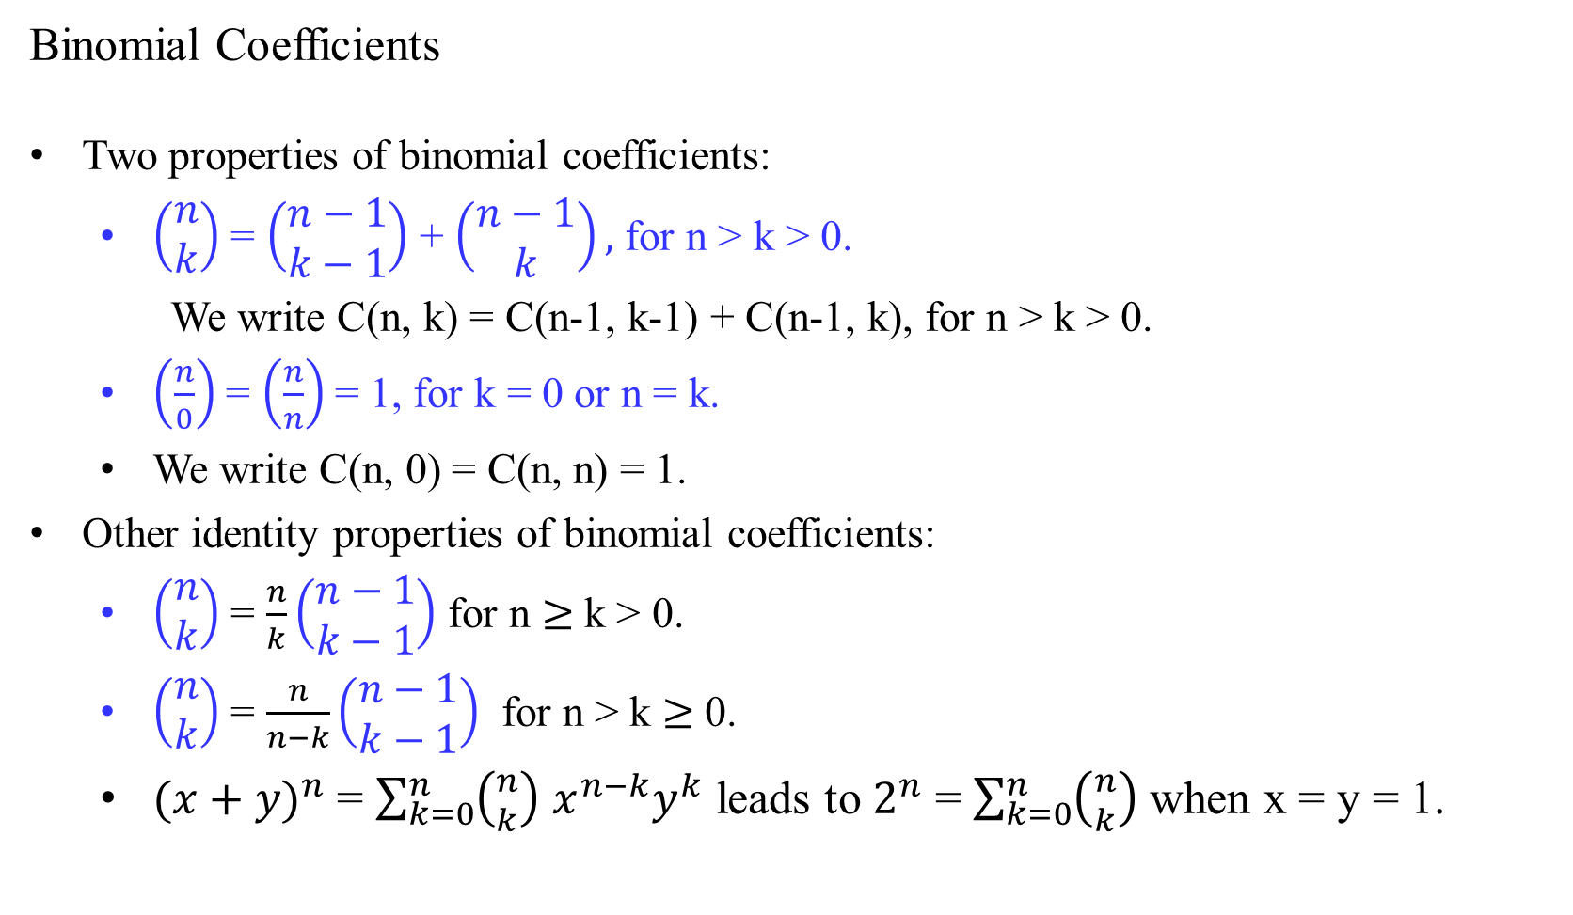
Binomial Coefficients
Two properties of binomial coefficients:
$\left(\begin{matrix}n \\ k\end{matrix}\right)$ = $\left(\begin{matrix}n−1 \\ k−1\end{matrix}\right)$ + $\left(\begin{matrix}n−1 \\ k\end{matrix}\right),$ for n > k > 0.
We write C(n, k) = C(n-1, k-1) + C(n-1, k), for n > k > 0.
$\left(\frac{n}{0}\right)$ = $\left(\frac{n}{n}\right)$ = 1, for k = 0 or n = k.
We write C(n, 0) = C(n, n) = 1.
Other identity properties of binomial coefficients:
$\left(\begin{matrix}n \\ k\end{matrix}\right)$ = $\frac{n}{k}\left(\begin{matrix}n−1 \\ k−1\end{matrix}\right)$ for n $≥$ k > 0.
$\left(\begin{matrix}n \\ k\end{matrix}\right)$ = $\frac{n}{n−k}\left(\begin{matrix}n−1 \\ k−1\end{matrix}\right)$ for n > k $≥$ 0.
${(x+y)}^{n}$ = $\sum_{k=0}^{n}{\left({n \atop k}\right) x^{n−k}y^{k}}$ leads to $2^{n}$ = $\sum_{k=0}^{n}{\left({n \atop k}\right) }$when x = y = 1.

Slide 14
Binomial Coefficients
Compute C(n, k), using the two properties of binomial coefficients:
C(n, k) = C(n-1, k-1) + C(n-1, k), for n > k > 0.
C(n, 0) = C(n, n) = 1.
n ^{k} | 0 | 1 | 2 | 3 | … | k-1 | k
0 | 1
1 | 1 | 1
2 | 1 | 2 | 1
3 | 1 | 3 | 3 | 1
…
k | 1 |  |  |  |  |  | 1
…
n-1 | 1 |  |  |  |  | C(n -1, k-1) | C(n-1, k)
n | 1 |  |  |  |  |  | C(n, k)

Slide 15
Binomial Coefficients
Compute C(n, k), using the two properties of binomial coefficients:
C(n, k) = C(n-1, k-1) + C(n-1, k), for n > k > 0.
C(n, 0) = C(n, n) = 1.
n ^{k} | 0 | 1 | 2 | 3 | … | k-1 | k
0 | 1
1 | C(1,0) = 1 | 1
2 | C(2, 0) = 1 | C(2, 1) = 2 | 1
3 | 1 | C(3, 1) = 3 | C(3, 2) = 3 | 1
…
k | C(k, 0) = 1 |  |  |  |  |  | 1
…
n-1 | 1
n | 1
C(1, 0) = C(n, 0) = 1
C(2, 1) = C(1, 0) + C(1, 1)= 1 + 1 = 2
C(3, 1) = C(2, 0) + C(2, 1)= 1 + 2 = 3
C(3, 2) = C(2, 1) + C(2, 2)= 2 + 1 = 3

Slide 16
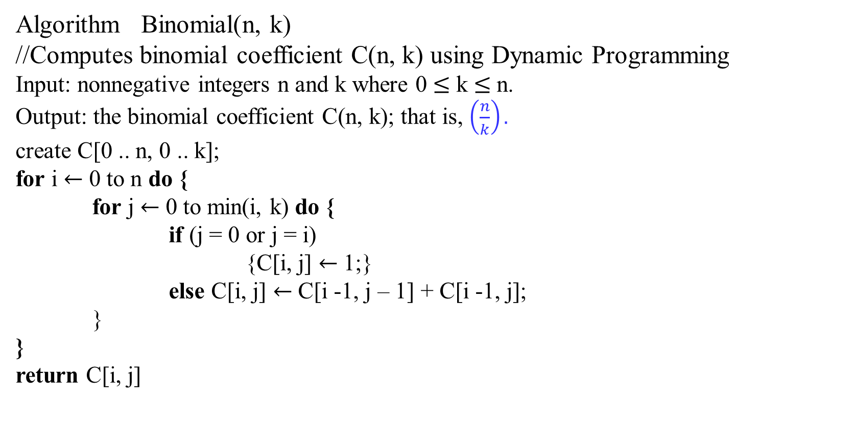
Algorithm Binomial(n, k)
//Computes binomial coefficient C(n, k) using Dynamic Programming
Input: nonnegative integers n and k where 0 $≤$ k $≤$ n.
Output: the binomial coefficient C(n, k); that is, $\left(\frac{n}{k}\right).$
create C[0 .. n, 0 .. k];
for i $←$ 0 to n do {
for j $←$ 0 to min(i, k) do {
if (j = 0 or j = i)
{C[i, j] $←$ 1;}
else C[i, j] $←$ C[i -1, j – 1] + C[i -1, j];
}
}
return C[i, j]

Slide 17
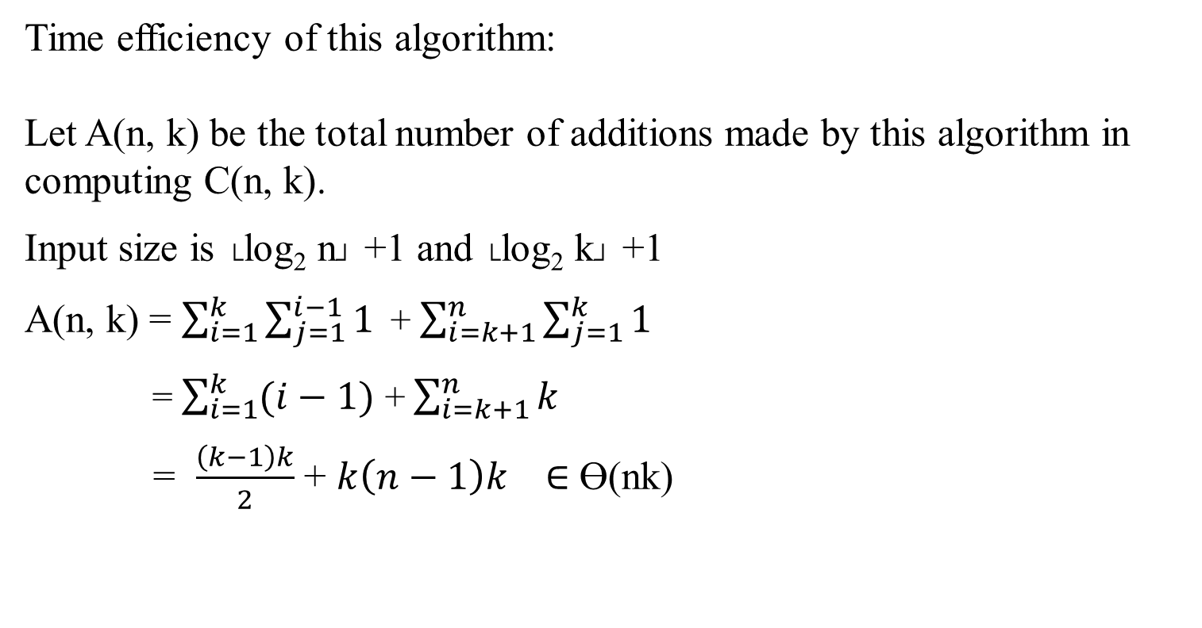
Time efficiency of this algorithm:
Let A(n, k) be the total number of additions made by this algorithm in computing C(n, k).
Input size is └log₂ n┘ +1 and └log₂ k┘ +1
A(n, k) = $\sum_{i=1}^{k}{\sum_{j=1}^{i−1}{1}}$+ $\sum_{i=k+1}^{n}{\sum_{j=1}^{k}{1}}$
= $\sum_{i=1}^{k}{(i−1)}$ + $\sum_{i=k+1}^{n}{k}$
= $\frac{\left(k−1\right)k}{2}$ + $k\left(n−1\right)k ∈$ ϴ(nk)

Slide 18
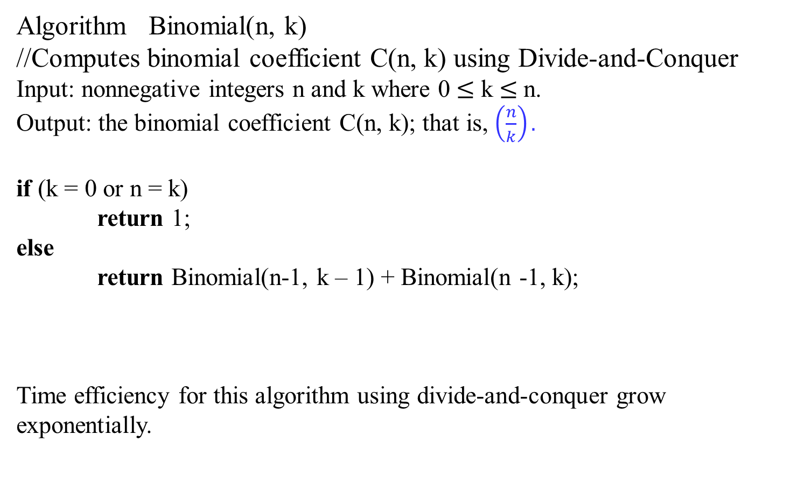
Algorithm Binomial(n, k)
//Computes binomial coefficient C(n, k) using Divide-and-Conquer
Input: nonnegative integers n and k where 0 $≤$ k $≤$ n.
Output: the binomial coefficient C(n, k); that is, $\left(\frac{n}{k}\right).$
if (k = 0 or n = k)
return 1;
else
return Binomial(n-1, k – 1) + Binomial(n -1, k);
Time efficiency for this algorithm using divide-and-conquer grow exponentially.

Slide 19
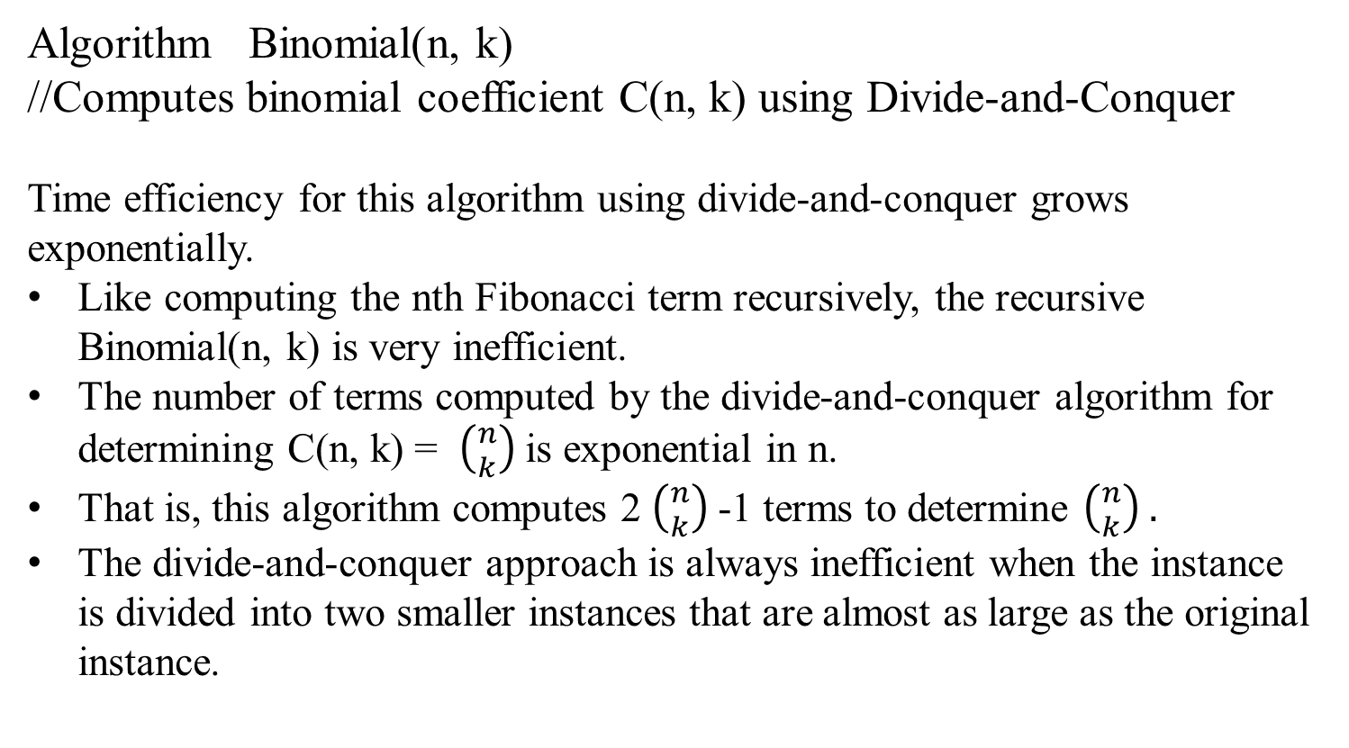
Algorithm Binomial(n, k)
//Computes binomial coefficient C(n, k) using Divide-and-Conquer
Time efficiency for this algorithm using divide-and-conquer grows exponentially.
Like computing the nth Fibonacci term recursively, the recursive Binomial(n, k) is very inefficient.
The number of terms computed by the divide-and-conquer algorithm for determining C(n, k) = $\left({n \atop k}\right)$is exponential in n.
That is, this algorithm computes 2 $\left({n \atop k}\right)$ -1 terms to determine $\left({n \atop k}\right) .$
The divide-and-conquer approach is always inefficient when the instance is divided into two smaller instances that are almost as large as the original instance.

Slide 20
Consider again the Fibonacci numbers.
The Fibonacci numbers are the elements of the sequence
0, 1, 1, 2, 3, 5, 8, 13, 21, 34, 55, 89, 144, 233, …
which can be defined by the simple recurrence
F(n) = F(n – 1) + F(n – 2) for n > 1 … 8.1
with two initial conditions
F(0) = 0, F(1) = 1 … 8.2
Using the recurrence (8.1) to compute the nth Fibonacci number F(n), the same values of this function would have to recompute many times.
F(n) = (F(n-1) + F(n-1))
= (F(n-2) + F(n-3)) + (F(n-3) + F(n-4))
= ((F(n-3) + F(n-4)) + (F(n-4) + F(n-5))) + ((F(n-4) + F(n-5)) + (F(n-5) + F(n-6)))
= (((F(n-4) + F(n-5)) + (F(n-5) + F(n-6)))) + ((F(n-5) + F(n-6)) + (F(n-6) + F(n+7)))) + …))

Slide 21
The following algorithm is constructed based on this definition.
Algorithm F(n)
//Based on definition, computes the nth Fibonacci number
//recursively
Input: A nonnegative integer n
Output: The nth Fibonacci number
if n ≤ 1 return n
else return F(n-1) + F(n-2);
The efficiency of this algorithm can be computed from the
recurrence relation:
A(n) = A(n-1) + A(n-2) + 1.
A(1) = 0. A(0) = 0.

Slide 22
Algorithm F(n)
…
if n ≤ 1 return n
else return F(n-1) + F(n-2);
F(5)
F(4) F(3)
F(3) F(2) F(2) F(1)
F(2) F(1) F(1) F(0) F(1) F(0)
F(1) F(0)
Analysis:
To compute F(4)
it requires computing F(2) twice, each of F(3) and F(4) once. (4 +’s)
To compute F(5)
it requires computing F(2) thrice, F(3) twice, and each of F(4) and F(5) once. (7 +’s)
Figure 2.6 Tree of recursive calls for computing the 5th Fibonacci number by the definition-based algorithm.

Slide 23
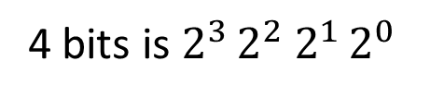
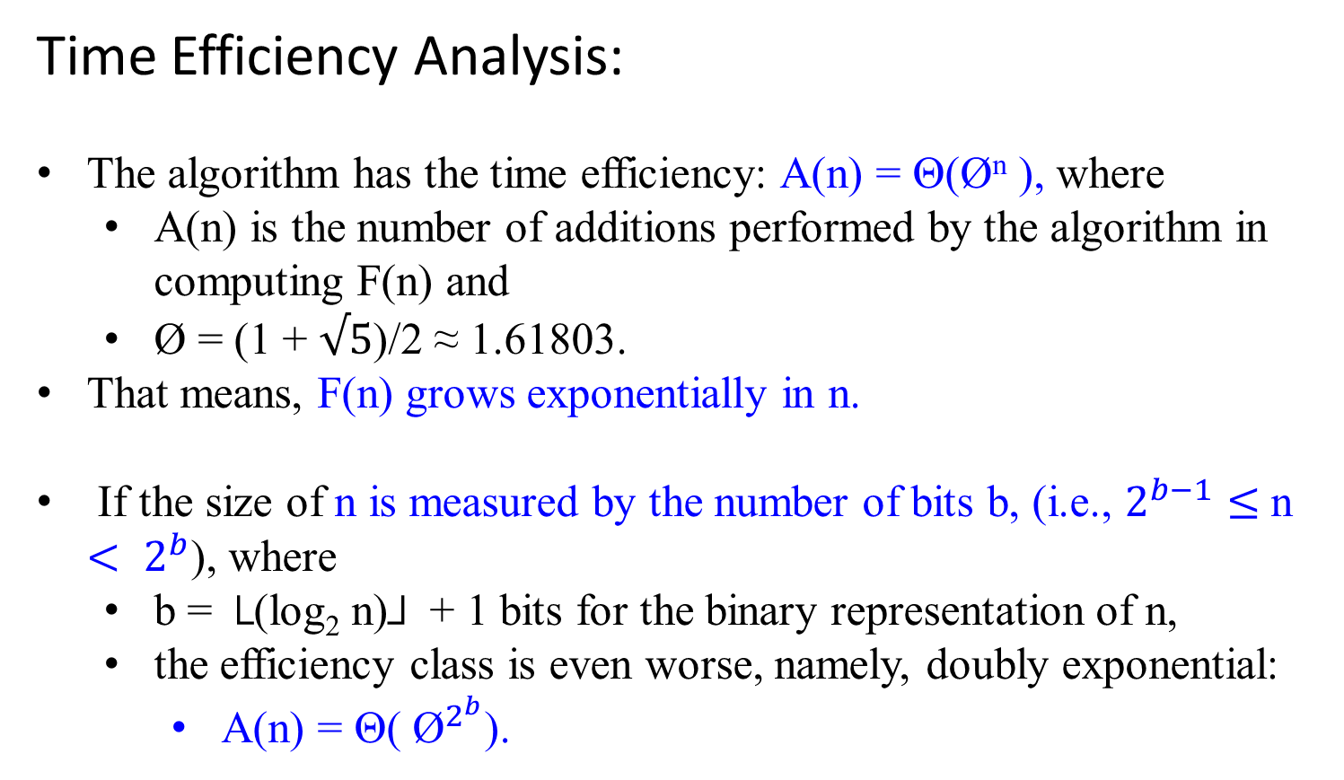
Time Efficiency Analysis:
The algorithm has the time efficiency: A(n) = Θ(Ø^{n} ), where
A(n) is the number of additions performed by the algorithm in computing F(n) and
Ø = (1 + $√5$)/2 ≈ 1.61803.
That means, F(n) grows exponentially in n.
If the size of n is measured by the number of bits b, (i.e., $2^{b−1}≤$n $<$ $2^{b}$), where
b = └(log₂ n)┘ + 1 bits for the binary representation of n,
the efficiency class is even worse, namely, doubly exponential:
A(n) = Θ( ${\text{Ø}}^{2^{b}}$).
4 bits is $2^{3 }2^{2}{ 2}^{1 }2^{0 }$

Slide 24
The problem of computing F(n) is expressed in terms of its smaller and overlapping subproblems of computing F(n – 1) and F(n – 2).
For avoiding to computing overlapping subproblems repeatedly:
Create one-dimensional array for storing n + 1 consecutive values of F(n) by:
starting with F(0) = 0, and F(1) = 1 through F(n),
where F(n) = F(n – 1) + F(n – 2) for n > 1.
A single-loop faster algorithm can be used by computing successive elements of the Fibonacci sequence iteratively:
0 | 1 | 1 | 2 | 3 | 5 | … | n

Slide 25
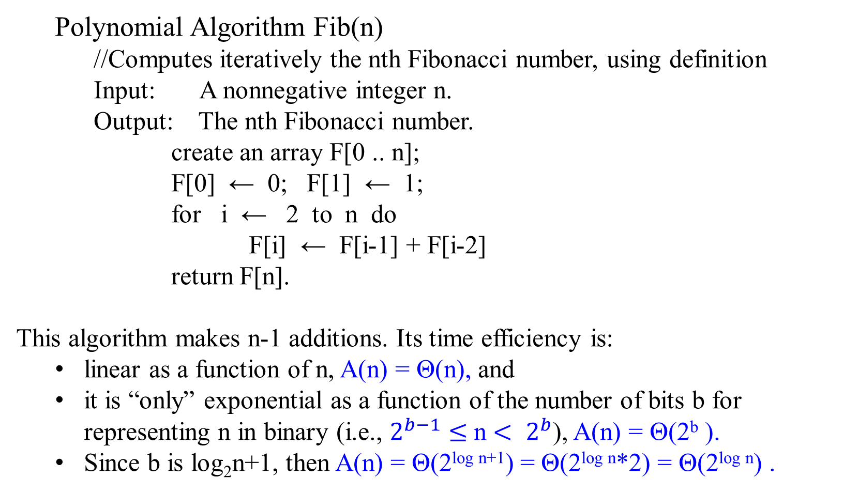
Polynomial Algorithm Fib(n)
//Computes iteratively the nth Fibonacci number, using definition
Input: A nonnegative integer n.
Output: The nth Fibonacci number.
create an array F[0 .. n];
F[0] ← 0; F[1] ← 1;
for i ← 2 to n do
F[i] ← F[i-1] + F[i-2]
return F[n].
This algorithm makes n-1 additions. Its time efficiency is:
linear as a function of n, A(n) = Θ(n), and
it is “only” exponential as a function of the number of bits b for representing n in binary (i.e., $2^{b−1}≤$n $<$ $2^{b}$), A(n) = Θ(2^{b} ).
Since b is log₂n+1, then A(n) = Θ(2^{log n+1}) = Θ(2^{log n}*2) = Θ(2^{log n}) .
0 | 1 | 1 | 2 | 3 | … | n-1 | n

Slide 26
Avoid Using an Extra Array
This improved Polynomial Algorithm Fib(n) requires only Ɵ(1) space by keeping the last two elements of the Fibonacci sequence..
At most, three locations are needed,
F(I - 2), F(I - 1), Temp

Slide 27
Further Improvement
The time efficiency for computing the Fibonacci sequence can be improved further.
The improved method begins with the equations
F₁ = F₁ and F₂ = F₀ + F₁
in matrix notation.
F₁ 0 1 F₀ F₁ = F₁
₌
F₂ 1 1 F₁ F₂ = F₀ + F₁

Slide 28
Q: F_{n+1} = (x)F₀ + yF₁, where x = F_{n} and y = x + F_{n-1} ?
F₁ 0 1 F₀ F₁ = F₁
F₂ 1 1 F₁ F₂ = F₀ + F₁
F₂ 0 1 F₁ F₂ = F₁
F₃ 1 1 F₂ F₃ = F₁ + F₂
0 1 ² F₀ 0 1 F₀
1 1 F₁ 1 2 F₁
F₃ = F₀ + 2F₁
F_{n} 0 1 ^{n} F₀ F₄ = 2F₀ + 3F₁
F₅ = 3F₀ + 5F₁
F_{n+1} 1 1 F₁ F₆ = 5F₀ + 8F₁
F₇ = 8F₀ + 13F₁
F₈ = 13F₀ + 21F₁
=
=
Similarly,
=
=
=
And in general
=
=

Slide 29
For computing F_{n ,} it suffices to raise this 2 x 2 matrix, (called it X), to the nth power.
We can show:
Multiplying two 2 x 2 matrices requires 4 additions (+) and 8 multiplications (*).
Computing X^{n} will take O(log n).
X² takes 4 +s and 8 *s.
X⁴ = X² X² takes 2*(4 +s and 8 *s).
X⁸ = X² X² X² X² = X⁴ X⁴ takes 3*(4 +s and 8 *s). …
In general, X^{n} takes (log n)*(4 +s and 8 *s).
Thus, the number of arithmetic operations needed by our matrix-based algorithm for computing Fibonacci numbers is O(log n), as compared to O(n).
0 1 0 1 0*0 + 1*1 0*1 + 1*1
1 1 1 1 1*0 + 1*1 1*1 + 1*1
*
=

Slide 30
For computing F_{n ,} it suffices to raise this 2 x 2 matrix, (called it X), to the nth power.
We can show:
Multiplying two 2 x 2 matrices requires 4 additions (+) and 8 multiplications (*).
X² takes 4 +s and 8 *s.
X⁴ = X² X² takes 2*(4 +s and 8 *s).
X⁸ = X² X² X² X² = X⁴ X⁴ takes 3*(4 +s and 8 *s).
X¹⁶ = X² X² X² X² X² X² X² X² = X⁸ X⁸ takes 4*(4 +s and 8 *s).
X³² = X¹⁶ X¹⁶ takes 5*(4 +s and 8 *s).
X⁶⁴ = X³² X³² takes 6*(4 +s and 8 *s). X¹²⁸ = X⁶⁴ X⁶⁴ takes 7*(4 +s and 8 *s).
In general, X^{n} takes (log n)*(4 +s and 8 *s).
Computing X^{n} will take O(log n).
0 1 0 1 0*0 + 1*1 0*1 + 1*1
1 1 1 1 1*0 + 1*1 1*1 + 1*1
*
=

Slide 31
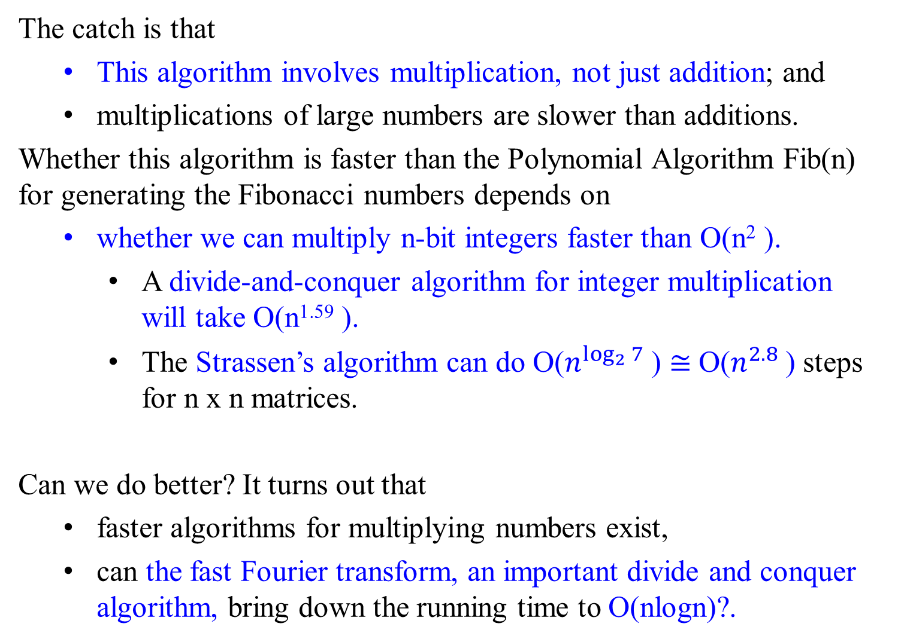
The catch is that
This algorithm involves multiplication, not just addition; and
multiplications of large numbers are slower than additions.
Whether this algorithm is faster than the Polynomial Algorithm Fib(n) for generating the Fibonacci numbers depends on
whether we can multiply n-bit integers faster than O(n² ).
A divide-and-conquer algorithm for integer multiplication will take O(n^{1.59} ).
The Strassen’s algorithm can do O($n^{\log_{2}{7}}$) $≅$ O($n^{2.8}$) steps for n x n matrices.
Can we do better? It turns out that
faster algorithms for multiplying numbers exist,
can the fast Fourier transform, an important divide and conquer algorithm, bring down the running time to O(nlogn)?.

Slide 32
Dynamic Programming algorithm
An application of dynamic programming can be interpreted as
a special variety of space-for-time trade-off.
A dynamic programming algorithm can sometimes be refined
to avoid using extra space.

Slide 33
Certain algorithms compute the n^{th} Fibonacci number without computing all the preceding elements of the sequence of Fibonacci numbers.
For the classic bottom-up dynamic programming approach,
an algorithm can solve all smaller subproblems of a given problem.
e.g., Algorithm F(n)
Time efficiency is A(n) = Θ(Ø^{n} ).
For the top-down variation of dynamic programming,
an algorithm uses so-called memory functions to avoid solving unnecessary subproblems.
e.g., Algorithm Fib(n)
Time efficiency is A(n) = Θ(n ),

Slide 34
Certain algorithms compute the nth Fibonacci number without computing all the preceding elements of this sequence.
For using the classical bottom-up version or its top-down variation of dynamic programming:
the crucial step in designing such as algorithm remains the same:
deriving a recurrence relating
a solution to the problem
to
solutions to its smaller subproblems.

Slide 35
Dynamic Programming Method
Applying the dynamic programming method to solve optimization problems, it requires
the principle of optimality:
an optimal solution to any instance of an optimization problem is composed of optimal solutions to its sub-instances.
Developing a dynamic programming algorithm includes:
establish a recursive property
that gives the solution to an instance of the problem.
Solve an instance of the problem in a bottom-up fashion
by solving smaller instances first.
(The dynamic programming is therefore a bottom-up approach.)

Slide 36
End of Chapter 06_01 Dynamic Programming

Slide 37
Chapter 06_02
Dynamic Programming
Principle of Optimality with Basic Examples

